Slide 1
Early Psychiatric Rehospitalization Prediction
Anh Tran
CSE 6748 Applied Analytics Practicum
presentation

Slide 2
Overview
Background and Objective
Methods
Key Elements
Predictive Model Pipeline
Results
CYF findings
AOA findings
Discussion

Slide 3
Background and Objective

Slide 4
Early psychiatric rehospitalization (EPR)
Early psychiatric rehospitalization (EPR) occurs when a client is readmitted to a psychiatric inpatient service within 90 days from the previous inpatient psychiatric hospital discharge.
EPR is disruptive for clients and their families, increases the risk of complication, and represents a strain on limited health care resources (Vigod et al., 2013).
Previous studies have identified some associations between psychiatric rehospitalization and client-level characteristics such as age, comorbidities, diagnostics, length of stay in the hospital, clinical history, type of service history and many other factors (Yu et al. 2015, Hung et al. 2017, Donisi et al. 2016, Zhao et al. 2020).
Being able to identify influencing factors and predict the likelihood of EPR can help health care providers to provide early intervention and appropriate post-discharge care for the high-risk clients in order to reduce rehospitalization rate.
Notes:
Previous studies have identified some associations between psychiatric rehospitalization and client-level characteristics such as age, comorbidities, diagnostics, length of stay in the hospital, clinical history, type of service history and many other factors (Yu et al. 2015, Hung et al. 2017, Donisi et al. 2016, Zhao et al. 2020). Specifically, previous admissions and the amount of previous psychiatric service (Hamilton et al. 2016, Hung et al. 2017), diagnosis of schizophrenia, bipolar disorder, or depression (Hamilton et al. 2016, Hung et al. 2017), homeless at admission and discharge (Laliberté et al. 2019), living alone (Hung et al. 2017, Webber et al. 2004, Zhao et al. 2020), and having substance use disorders (Morel et al. 2020) are reliable predictors of readmission.

Slide 5
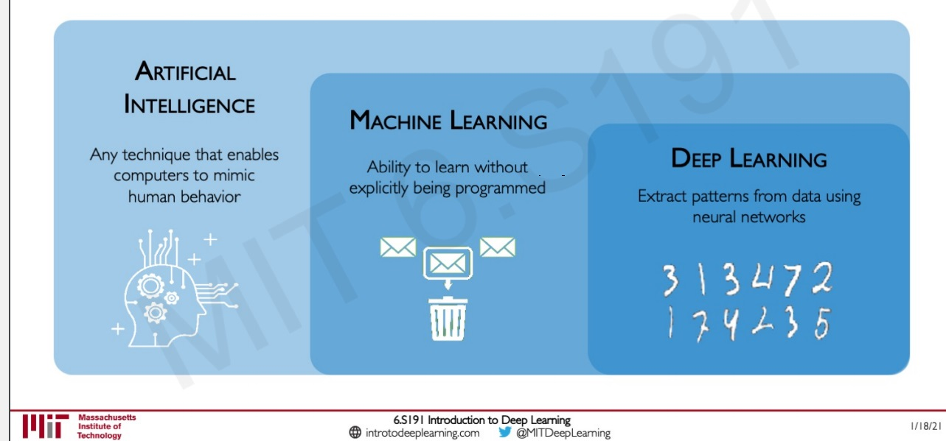
Machine learning approach
With the abundance of data and input features, many recent studies have applied machine learning approach to develop hospitalization/rehospitalization prediction models such as:
Supervised learning models: Logistic Regression, Naïve Bayes, etc. (Li et al. 2020)
Random forest (Zhao et al., 2020)
Gradient boosted decision trees XGBoost (Morel et al. 2020)
Generalized linear model (GLM), ensemble methods and deep learning (Blankers et al. 2020)
Notes:
With the abundance of administrative records of inpatient clients and high dimensionality of psychiatric data, many recent studies have applied machine learning (ML) approach to detect complex patterns among risk factors and to develop hospitalization/rehospitalization prediction models. For example, Zhao et al. 2020 used random forest, a tree-based classification algorithm, to identify top risk factors for EPR. Blankers et al. 2020 applied ten machine learning algorithms, including the traditional statistical technique - generalized linear model (GLM/logistic regression) to predict psychiatric hospitalization. Morel et al. 2020 used the ensemble model, a technique that combines individual models to boost the performance, such as extreme gradient boosting to predict psychiatric readmission.

Slide 6
Objectives
1) Predict 90/60/30/7-day rehospitalization since a previous inpatient psychiatric hospital discharge for CYF population and identify the influencing factors.
2) Predict 90/60/30/7-day rehospitalization since a previous inpatient psychiatric hospital discharge for AOA population and identify the influencing factors.
Notes:
Despite the considerable number of studies on readmission prediction, most EPR predictive models are designed for 90-day psychiatric rehospitalization and focus on the adult population. It is essential to predict rehospitalization earlier than 90 days and identify the unique factors contributing to the likelihood of the readmission for both the children/ teenager as well as the the adult populations.

Slide 7
Methods

Slide 8
Key Elements
Client data source
Outputs and predictor variables
Machine learning models

Slide 9
Client data source
Data source: Cerner Community Behavioral Health (CCBH)
Data Warehouse database in Microsoft SQL Server at HSRC
Dataset:
Inpatient assignment data was pulled from 07/01/2008 to 06/30/2020 (12 years)
Each row in the dataset includes a hospital stay, also known as the “index hospitalization”, and the subsequent hospital stay called the “readmission.”
The dataset includes client demographics, all services received before the index hospitalization, level of care, and the 7, 30, 60 and 90-day readmissions.
118,893 psychiatric hospitalization records of 44,605 clients who have received at least one psychiatric IP service.
CYF sample includes 13,950 hospitalizations of 6,310 unique clients
AOA sample includes 104,920 cases of 38,272 unique clients

Slide 10
Outputs and predictor variables
Output: a dichotomized measure of client psychiatric rehospitalization within 7, 30, 60 or 90 days after being discharged from an index hospitalization.(4 analyses)
Predictor variables:
Excluded variables with 30% or more missing data
Notes:
The primary outcome of interest was a dichotomized measure of client psychiatric rehospitalization within 7, 30, 60 or 90 days after being discharged from an inpatient service (the index hospitalization). Each of these timeframe outcomes were analyzed separately.
CYF: trauma, sexual orientation, primary care physician
AOA: veteran, marital status, domestic abuse

Slide 11
 | Candidate predictor variables
Themes | CYF | AOA
Demographics | Age (num), Age group (cat), Gender (cat), Race (cat), Primary language (cat), Psychiatric diagnosis (cat), Living situation (cat), Insurance status (cat), co-occurring substance use (cat)
 | Receive Child Welfare Services/ CWS (cat), Receive Alcohol and Drug Services/ADS (cat), Probation or Juvenile Justice/JJ Involvement (cat) | Employment status (cat), Education status (cat), Sexual orientation (cat), Jail/Justice Involvement (cat)
Length and history of psychiatric hospitalization | First time being hospitalized (cat) Days in the psychiatric hospital in last 12 months (num) Number of psychiatric hospitalizations in lifetime (num) Type of psychiatric hospitalization (cat)
Number of total services | Number of all services up to the index hospitalization (num) Number of services before the index hospitalization since previous hospitalization (num) Number of services before the index hospitalization since previous hospitalization at same subunit (num)
Service group received up to 7/30/60/90 days before the index hospitalization | Number of Outpatient (OP) Services (num) Number of Emergency/Crisis Services (num) Number of Inpatient (IP) Services (num)
 | Days in Day (DT) Services (num) |  | Days in 24-hour Services (num)
Order of LOC services | 1st LOC service received before the index hospitalization (cat) 2nd LOC service received before the index hospitalization (cat) 3rd LOC service received before the index hospitalization (cat) 4th LOC service received before the index hospitalization (cat) 5th LOC service received before the index hospitalization (cat)
Discharge | Discharge Status (cat)
Total Variables | 185 |  | 258

Slide 12
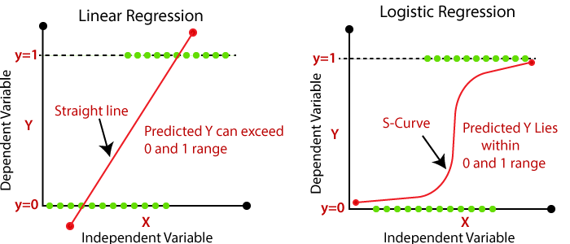
Machine learning algorithms
Algorithm | Descriptions
Logistic Regression | A statistical algorithm used to estimate the probability of a binary (0-1) outcome using the Sigmoid function
Notes:
Logistic Regression, also known as logit regression or logit model, is a statistical model used to estimate the probability of a binary (0-1) outcome. It uses the Sigmoid function, which is an S-shaped curve that takes input data and maps it into a value between 0 (event does not occur) and 1 (event occurs). This model is also considered a type of Generalized Linear Models (Nelder 1972). For our Logistic Regression model, “liblinear” solver was used to handle L1 penalty, which limits size of the coefficients.

Slide 13
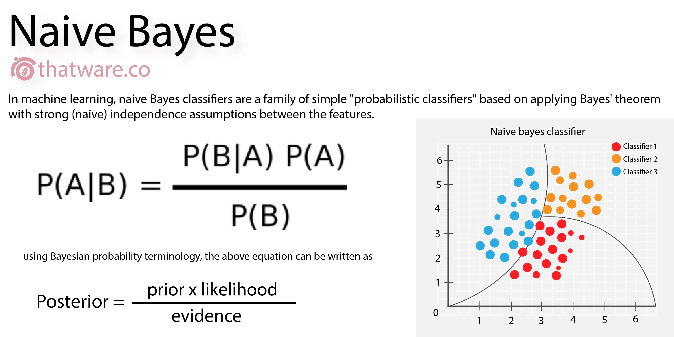
Machine learning algorithms
Algorithm | Descriptions
Naïve Bayes | A Bayes’ Theorem algorithm with an assumption of independence among predictors to classify cases into labels
Notes:
Naïve Bayes is a technique used to classify cases into labels (in our case rehospitalization Yes or No). The model is based on Bayes’ Theorem with an assumption of independence among predictors. For example, an animal may be considered to be a bird if it has two wings, two legs, a beak, feathers and lays eggs. Although these features depend on each other, each of them independently contributes to the probability that the animal is a bird and that is why it is known as ‘Naive’ (Hand 2001). The default Naïve Bayes model was used.

Slide 14
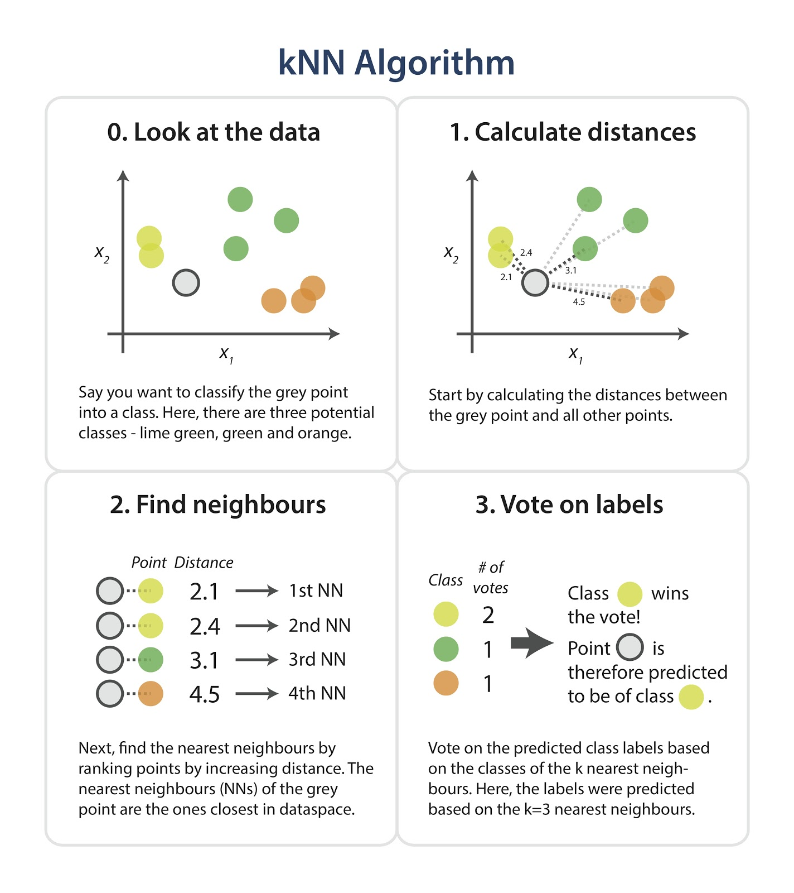
Machine learning algorithms
Algorithm | Descriptions
K-nearest neighbors (KNN) | An algorithm that estimates how likely a new case is to be a member of one group or the other depending on the majority of k (k>1) closest matching neighbor data
Notes:
K-nearest neighbors (KNN) is an algorithm that estimates how likely a new case is to be a member of one group or the other depending on the majority of k (k>1) closest matching neighbor data. KNN determines the closest matching neighbor by a similarity measure such as the Euclidean distance [formula = (√((X1−X2)^2+(Y1−Y2)^2)] between two data points (Altman 1992). We used k=3 in our KNN model.

Slide 15
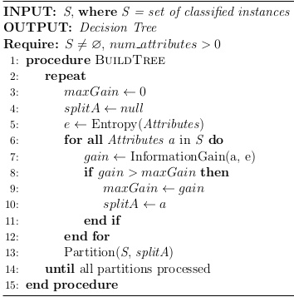
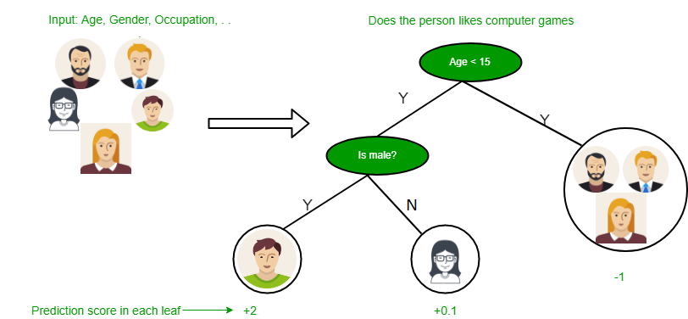
Machine learning algorithms
Algorithm | Descriptions
Decision Tree | An upside-down-tree-like model that repeatedly partitions the data into a number of smaller subgroups (called leaf nodes) with similar response values based on a set of decision rules (called decision nodes) in order to predict the class label
Notes:
Decision Tree, also known as Classification and Regression Tree, is a robust algorithm that repeatedly partitions the data into a number of smaller subgroups (called leaf nodes) with similar response values based on a set of decision rules (called decision nodes) like an upside-down tree. The model tries to minimize cross-entropy or Gini index, a measure of purity to ensure the subset is as pure or homogeneous as possible, which is also where the branches stop splitting (Song 2015). Because our outcome variable is categorical, the model predicts the class label (i.e. rehospitalization Yes of No) from the class that has majority presentation in the subgroup. We used the default Decision Tree model.

Slide 16
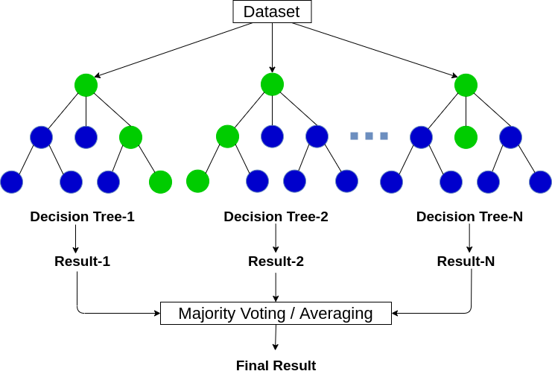
Machine learning algorithms
Algorithm | Descriptions
Random Forest | An algorithm that produces many decision trees. Each individual tree in the random forest makes a class prediction and the class with the most votes becomes the model’s prediction
Notes:
Random Forest is an ensemble learning method that produces many decision trees using the training data as an input. These tree are made by randomly selecting a number of predictors and a number of rows from the original dataset. Each individual tree in the random forest outputs a class prediction and the class with the most votes becomes the model’s prediction. Random forest is considered more reliable and stable than just a decision tree (Biau 2016). We used the default 100 trees for the Random Forest model.
Gradient Boosting is a ML technique that produces a strong prediction model in the form of an ensemble of weak prediction models, often in the form of decision trees. Gradient

Slide 17
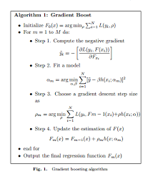
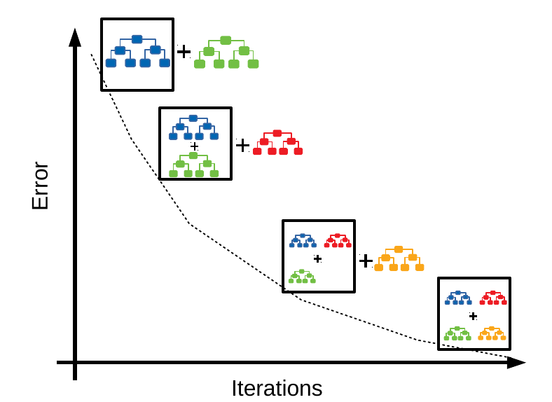
Machine learning algorithms
Algorithm | Descriptions
Gradient Boosting | An algorithm that produces a strong prediction model in the form of an ensemble of weak prediction models, often in the form of decision trees.
Notes:
Gradient Boosting is a ML technique that produces a strong prediction model in the form of an ensemble of weak prediction models, often in the form of decision trees. Gradient Boosting trains many models in a gradual, additive and sequential manner in order to optimize a loss function, a measure indicating how good model’s coefficients are at fitting the underlying data (Natekin 2013). In our case, the loss function is a measure of how good our predictive model is at classifying rehospitalization. We also used the default 100 trees for the Gradient Boosting model.

Slide 18
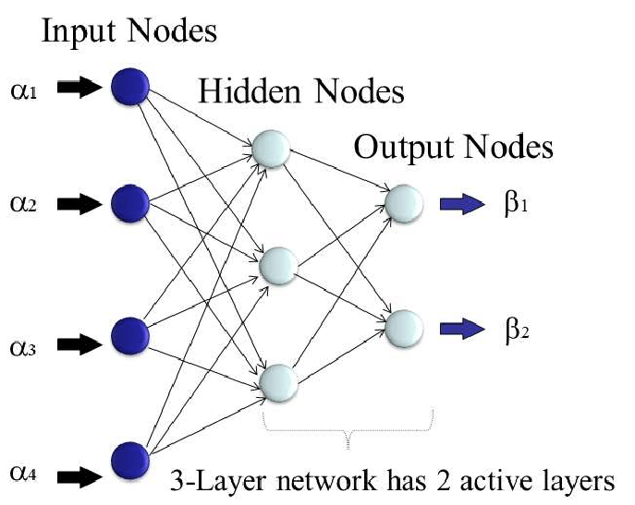
Machine learning algorithms
Algorithm | Descriptions
Artificial Neural Networks | A model inspired by the biological neural networks of the brain to learn tasks based on provided examples, without being explicitly programmed
Notes:
Artificial Neural Networks, or simply called Neural Networks, is a ML model inspired by the biological neural networks of the brain. It is modelled to learn tasks based on provided examples, without being explicitly programmed. A neural network can have any number of layers with any number of neurons in those layers. The inputs are fed forward through the neurons in the network to get the output(s) at the end. During the transmission of the “signal” through the layers of neurons, there are weights and thresholds to moderate the strength of the signal at the connection to improve the prediction accuracy (van Gerven 2018). We used 100 neurons in 50 hidden layers with the hyperbolic tan function for our Neural Networks model.

Slide 19
Predictive model pipeline - Supervised Learning Models
Training input data
Feature vectors
Machine learning algorithm
Labeled outputs
Test input data
Feature vectors
Predictive model
Expected label

Slide 20
Predictive model pipeline – Feature Engineering
X_train
Imputing missing data with KNN algorithm
X: input/predictors
y: output
Training sample (80% of dataset)
y_train
Select 7/30/60/90 –day output
CYF / AOA Dataset
X_test
Imputing missing data with KNN algorithm
Testing sample (20% of dataset)
y_test
Select 7/30/60/90 –day output
Notes:
For each population (CYF/AOA) x each output (7/30/60/90-day readmissions), we applied stratified sampling technique. The dataset was split at 80% as training dataset and the remaining 20% as test dataset with respect to the output variable. This technique ensures that the training and test sets have approximately the same percentage of samples of each output class as the complete set.
In stratified sampling, researchers divide subjects into subgroups called strata based on characteristics that they share (e.g., race, gender, educational attainment, etc). Once divided, each subgroup is randomly sampled using another probability sampling method.

Slide 21
Predictive model pipeline – Feature Engineering (continued)
Categorical variables
One-hot encoded
Synthetic Minority Oversampling Technique
Normalize the input features with the Min-Max scaler
Processed X_train
Input features
Numerical variables
Processed y_train
Categorical variables
One-hot encoded
Normalize the input features with the Min-Max scaler
Processed X_test
Input features
Numerical variables
Processed y_test
Notes:
To impute the missing data, we applied the KNN algorithm on the training and test datasets. The number of k neighbors were determined by the formula: [take square root the number of predictors and then divided by 2]. Because the KNN only takes numerical values, each label in each categorical variable were encoded as a number based on the alphabetical order. After imputing, these numbers were converted back to their corresponding labels.
Categorical variables were one-hot encoded: each category in each categorical variable is represented by a dummy variable, where 1 indicates the category and 0 otherwise. Since one-hot-encoding directly induces multicollinearity, we dropped one of the columns from the encoded features.
Both numeric and categorical predictors were combined to create the input features. Because the ML models require data to be scaled and Gaussian distribution is preferred, we applied the Min-Max scaling technique to normalize the input data for both the training and test datasets. This technique shifts and rescale values so that they end up ranging between 0 and 1
The Yes:No rehospitalization of each timeframe outcome is imbalanced; there are much fewer rehospitalized cases than the non-rehospitalized ones. Plus, the shorter the timeframe is, the wider the ratio gap is. This would impact the ML models because they would have poor performance on the minority class (i.e. Rehospitalization Yes), which is our outcome of interest. To resolve this problem, we applied a sampling technique called Synthetic Minority Oversampling Technique, or SMOTE. The algorithm is similar to the KNN. It selects samples in the minority class that are close to each other and then draws lines between them. New sample points are generated from the points on these lines (Chawla et al. 2002). Because we need to ensure the integrity of the test dataset for the evaluation purpose, only the training dataset was augmented.

Slide 22
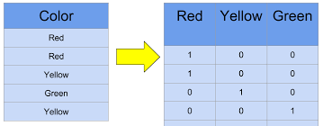
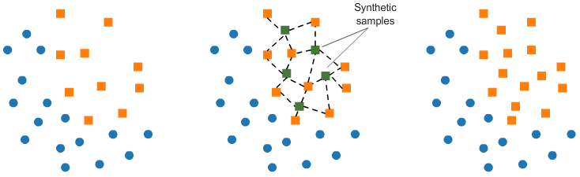
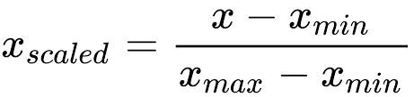
One-hot encoded example
SMOTE example
Min-Max scaler formula

Slide 23
Predictive model pipeline – Modelling
There are three sets of predictor variables used for the ML models: 1) all variables, 2) variables selected from the Correlation and Boruta algorithm and 3) variables selected from the feature importance produced by ML models.
Training sample
Testing sample
All features
ML models
Model Evaluation
Important features
Selected features from the Boruta algorithm
Tuning best feature set and best model
Notes:
Pearson correlation coefficients for numerical variables and Cramer's V (strength of association) coefficients for categorical variables were computed. Any feature with coefficient > 0.9 was considered redundant and excluded. After that, the Boruta variable selection was applied. The Boruta algorithm is a wrapper built around the random forest classification algorithm. It tries to capture all the important features in the dataset with respect to an outcome variable. The idea behind this algorithm is that the features compete with a randomized version of themselves, which are called shadow features created by duplicating the dataset and shuffling the values in each column. The importance of each original features is compared with a threshold, which is defined as the highest feature importance recorded among the shadow features. After a number of defined iterations, a feature is selected only if it’s capable of doing better than its best randomized version (Kursa 2010). The strongly and moderately predictive features were selected as the final second set for the ML models.
Feature importance refers to techniques that assign a score to input features based on how useful they are at predicting an outcome after fitting the training data into the model. The higher the value the more important the feature. For the tree-based models (i.e. Decision Tree, Random Forest and Gradient Boosting), feature importance score is calculated as the reduction in node impurity weighted by the probability of reaching that node. That is, features that tend to split nodes closer to the root of a tree will result in a larger importance value. The feature importance score can be retrieved easily from the feature_importances_ property of the trained tree-based models. The third set of variables were selected from the top 15 of the average feature importance scores of the three tree-based models. This method follows a two-step Big Data analytic approach (Zhao and Castellanos, 2016).

Slide 24
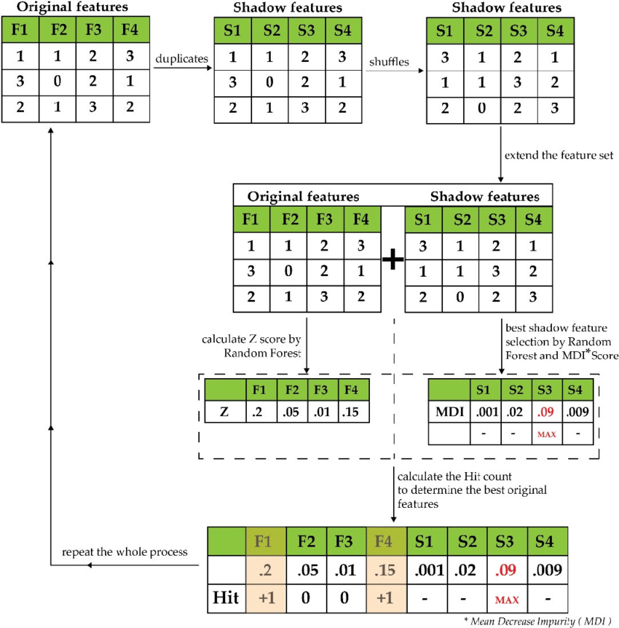
Boruta Algorithm example
Notes:
irst, it duplicates the dataset, and shuffle the values in each column. These values are called shadow features. * Then, it trains a classifier, such as a Random Forest Classifier, on the dataset. By doing this, you ensure that you can an idea of the importance -via the Mean Decrease Accuracy or Mean Decrease Impurity- for each of the features of your data set. The higher the score, the better or more important.
Then, the algorithm checks for each of your real features if they have higher importance. That is, whether the feature has a higher Z-score than the maximum Z-score of its shadow features than the best of the shadow features. If they do, it records this in a vector. These are called a hits. Next,it will continue with another iteration. After a predefined set of iterations, you will end up with a table of these hits.
At every iteration, the algorithm compares the Z-scores of the shuffled copies of the features and the original features to see if the latter performed better than the former. If it does, the algorithm will mark the feature as important. In essence, the algorithm is trying to validate the importance of the feature by comparing with random shuffled copies, which increases the robustness. This is done by simply comparing the number of times a feature did better with the shadow features using a binomial distribution.
If a feature hasn't been recorded as a hit in say 15 iterations, you reject it and also remove it from the original matrix. After a set number of iterations -or if all the features have been either confirmed or rejected- you stop.

Slide 25
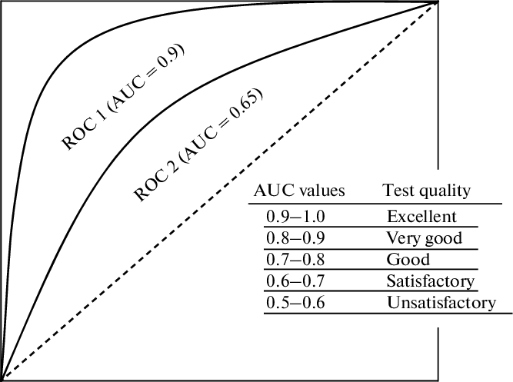
True Class
Positive
Negative
True Positive | False Positive
False Negative | True Negative
Positive
Predicted Class
Negative
The AUC-ROC (area under the ROC curve), or AUC for short, is a performance measurement for the classification problems at various threshold settings. ROC (Receiver Operating Characteristics) is a probability curve and AUC represents the degree or measure of separability. It tells how much the model is capable of distinguishing between classes.
True Positive rate
False positive rate
Notes:
There are seven main metrics to evaluate the performance of a ML model. They are: confusion matrix, accuracy, precision, recall, f1-score, precision-recall curve and AUC-ROC.
The confusion matrix is a straightforward table to view True and False Positive and Negative results.
The accuracy is the number of correct predictions over the total number of test dataset.
The precision is the ratio between the True Positives and all the Positives. It measures the model ability to not classify a case as positive, if it should be negative.
The recall is the measure of the model correctly identifying True Positives. It is the opposite of the precision.
The F1-score is the weighted harmonic mean of precision and recall (F1= 1 is the best).
The precision-recall curve is a metric for demonstrating the tradeoff between precision and recall for imbalanced datasets. The area under the precision-recall curve is the average precision score (AP = 1 is the best).
Overall accuracy is based on one specific cutpoint, while ROC tries all of the cutpoint and plots the sensitivity and specificity. So when we compare the overall accuracy, we are comparing the accuracy based on some cutpoint. The overall accuracy varies from different cutpoint.
As answered before, on imbalanced dataset using the majority run as a classifier will lead to high accuracy what will make it a misleading measure.
If you are digging for gold (a scenario in which you have huge benefit from a true positive, not too high cost of a false positive) then recall is a good measure.
If you are trying to decide whether to perform a complex medical procedure on people (high cost of false positive, hopefully a low cost of false negative), precision is the measure you should use.

Slide 26
Results
CYF Findings

Slide 27
CYF demographics (Total unique clients: 6,310)

Slide 28
CYF demographics (Total unique clients: 6,310)

Slide 29
CYF demographics (Total unique clients: 6,310)

Slide 30
In average, the clients in the CYF sample received 100.3 services up to the index hospitalization. 71.5 services were received before the index hospitalization since previous hospitalization but only 0.2 services at the same subunit/ program.
CYF services
Group of Services | Metrics | Within 90 days | Within 60 days | Within 30 days | Within 7 days
Outpatient Services | Total visits: | 219,817 | 157,980 | 88,538 | 26,674
 | Total clients: | 257 | 278 | 371 | 622
 | Percent user: | 4.1 | 4.4 | 5.9 | 9.9
Emergency Services | Total visits: | 56,466 | 48,457 | 38,954 | 29,094
 | Total clients: | 322 | 334 | 344 | 351
 | Percent user: | 5.1 | 5.3 | 5.5 | 5.6
Inpatient Services | Total visits: | 4,108 | 2,966 | 1,672 | 387
 | Total clients: | 766 | 738 | 676 | 288
 | Percent user: | 12.1 | 11.7 | 10.7 | 4.6
Day Services | Total days: | 67,343 | 45,527 | 22,445 | 4,988
 | Total clients: | 8 | 7 | 11 | 21
 | Percent user: | 0.1 | 0.1 | 0.2 | 0.3

Slide 31
The current CYF client sample has 1.3 psychiatric hospitalization (3.2 standard deviation) in average. The average length of stay in the psychiatric hospital is 6.6 days (18.4 days standard deviation). The gap between hospitalizations is 505.2 days or about 1.4 years.
CYF hospitalization and readmission rates

Slide 32
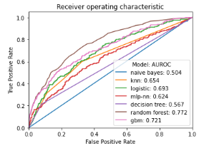
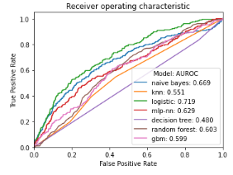
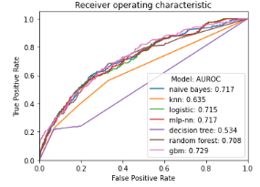
7-day readmission prediction

Slide 33
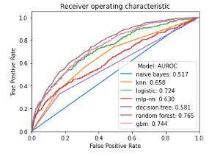
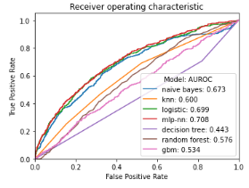
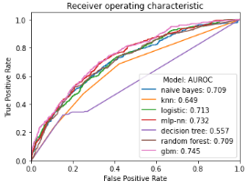
30-day readmission prediction

Slide 34
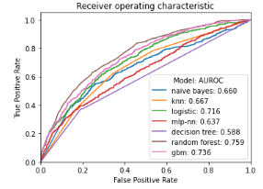
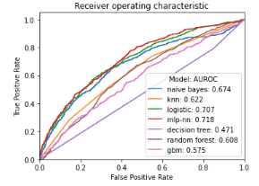
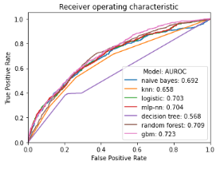
60-day readmission prediction

Slide 35
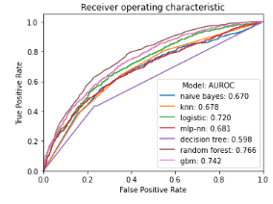
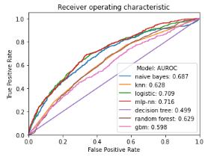
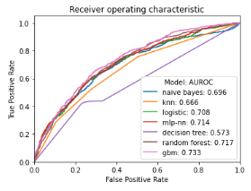
90-day readmission prediction

Slide 36
Final set of variables and model
The final model was the Gradient Boosting with Boruta-selected predictors.
There were three parameters that we tuned for the Gradient Boosting model: learning rate (moderate the contribution of each tree), n_estimators (the number of trees in the forest) and max_dept (how deep the built tree can be)
 | 7-day readmission | 30-day readmission | 60-day readmission | 90-day readmission
Learning rate | 0.1 | 0.1 | 0.1 | 0.1
N_estimators | 1000 | 500 | 500 | 1000
Max_depth | 7 | 7 | 4 | 7
Accuracy | 0.8680 | 0.7789 | 0.7653 | 0.7174
AUC | 0.8090 | 0.7824 | 0.8077 | 0.7583

Slide 38
CYF coefficients (Coef) of Logistic Regression model using of Boruta predictors by timeframes
 | 7-day readmission | 30-day readmission | 60-day readmission | 90-day readmission
svc_ip_30days_pre | 3.799367 | 4.401424 | 4.107667 | 4.100226
IP_history | 2.304024 | 2.346932 | 2.529734 | 2.668832
svc_pre_all | 0.396693 | 0.642057 | 0.404826 | 0.384198
svc_pre | -0.015104 | -1.053096 | -1.314142 | -0.631956
as_close_Home/Shelter | -0.491407 | -0.628238 | -0.226659 | -0.243241
as_loc_IPCAPS | -2.148970 | -1.665435 | -1.369292 | -1.236845
as_loc_IPFFS | -2.421381 | -1.817746 | -1.567102 | -1.385462
as_length_IP | -2.954058 | -1.632578 | -1.596086 | -1.110309
svc_ip_7days_pre | -3.492471 | -3.465995 | -3.258150 | -3.341092
svc_op_30days_pre | - | 1.787100 | 2.313307 | 1.905521
svc_es_30days_pre | - | 1.096795 | 1.367971 | 1.157350
Discharge _Satisfactorily Achieved Goals | - | -0.438637 | - | -
Live at House or Apartment | - | - | -0.304524 | -
loc2_pre_None | - | - | - | -0.428993

Slide 39
Results
AOA Findings

Slide 40
AOA demographics (Total unique clients: 38,272)

Slide 41
AOA demographics (Total unique clients: 38,272)

Slide 42
AOA demographics (Total unique clients: 38,272)

Slide 43
In average, the clients in the AOA sample received 55.6 services up to the index hospitalization. 32.6 services were received before the index hospitalization since previous hospitalization but only 0.3 services at the same subunit.
AOA services
Group of Services | Metrics | Within 90 days | Within 60 days | Within 30 days | Within 7 days
Outpatient Services | Total visits: | 491,466 | 346,263 | 192,847 | 62,783
 | Total clients: | 2,076 | 2,289 | 2,676 | 3,219
 | Percent user: | 4.8 | 5.2 | 6.1 | 7.4
Emergency Services | Total visits: | 312,409 | 258,965 | 193,694 | 123,911
 | Total clients: | 1,462 | 1,466 | 1,494 | 1,687
 | Percent user: | 3.3 | 3.4 | 3.4 | 3.9
Inpatient Services | Total visits: | 62,068 | 45,394 | 24,902 | 4,125
 | Total clients: | 5,726 | 5,651 | 5,359 | 2,363
 | Percent user: | 13.1 | 12.9 | 12.3 | 5.4
24-hour Services | Total days: | 15,481 | 7,514 | 3,309 | 1,179
 | Total clients: | 11 | 13 | 16 | 30
 | Percent user: | <0.1 | <0.1 | <0.1 | 0.1

Slide 44
The current AOA client sample has 1.8 psychiatric hospitalization (4.79 standard deviation) in average. The average length of stay in the psychiatric hospital is 11.3 days (38.8 days standard deviation). The gap between hospitalizations is 619.2 days or about 1.7 years.
AOA hospitalization and readmission rates

Slide 45
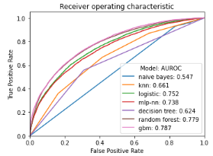
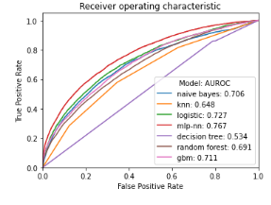
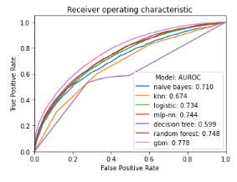
7-day readmission prediction

Slide 46
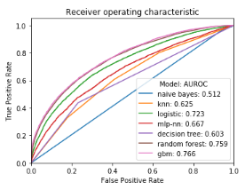
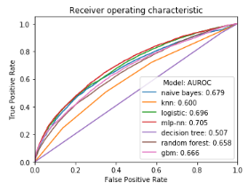
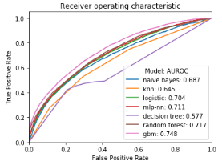
30-day readmission prediction

Slide 47
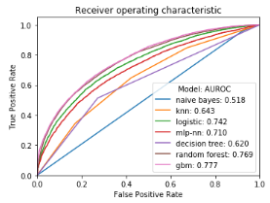
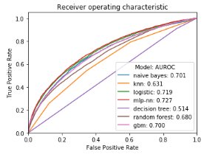
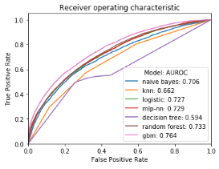
60-day readmission prediction

Slide 48
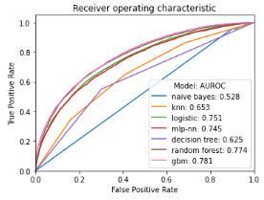
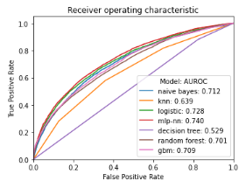
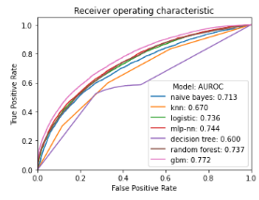
90-day readmission prediction

Slide 49
Final set of variables and model
The final model was the Gradient Boosting with Boruta-selected predictors.
There were three parameters that we tuned for the Gradient Boosting model: learning rate (moderate the contribution of each tree), n_estimators (the number of trees in the forest) and max_dept (how deep the built tree can be)
 | 7-day readmission | 30-day readmission | 60-day readmission | 90-day readmission
Learning rate | 1 | 0.1 | 0.1 | 0.01
N_estimators | 1500 | 1500 | 1500 | 1000
Max_depth | 4 | 6 | 4 | 5
Accuracy | 0.8734 | 0.7712 | 0.7342 | 0.7218
AUC | 0.7789 | 0.7785 | 0.7639 | 0.7769

Slide 51
AOA coefficients (Coef) of Logistic Regression model using of Boruta predictors by timeframes
 | 7-day readmission | 30-day readmission | 60-day readmission | 90-day readmission
Length in hospital | -9.34 | -3.20 | -4.21 | -3.93
History of hospitalization | 3.52 | 4.75 | 6.10 | 7.13
Numer of services up to index hospitalization | -2.71 | -1.95 | -1.46 | -1.24
Numer of services before index hospitalization since previous hospitalization | - | -3.57 | -3.27 | -2.95
Numer of services before index hospitalization since previous hospitalization at the same subunits | -0.40 | - | - | -
IP services 30 days before index hospitalization | 2.84 | 1.64 | 1.29 | -
IP services 60 days before index hospitalization | 1.76 | 3.09 | 3.33 | 4.30
ES services 7 days before index hospitalization | -0.02 | - | - | -
ES services 30 days before index hospitalization | 1.43 | - | - | -
ES services 60 days before index hospitalization | 0.41 | - | - | -
Received IP-FFS | 0.15 | 0.15 | 0.22 | 0.27
Received - IP LIHP | -0.23 | -0.38 | -0.34 | -0.40
No first LOC before index hospitalization | -0.14 | -0.13 | -0.22 | -0.24
Discharge status: to IMD/MHRC | - | -2.97 | -3.24 | -3.27
Discharge status: to Psychiatric Hospital | 2.73 | 1.94 | 1.66 | 1.56
Discharge status: to lower LOC | 1.13 | 0.72 | - | -
Discharge status: to Medical Hospital | 1.96 | - | - | -
Diagnosed with Depressive disorders | - | -0.26 | -0.27 | -0.30
Diagnosed with Schizophrenia/Psychotic disorders | - | 0.16 | 0.16 | 0.17
Unknown Education level | - | -0.30 | -0.38 | -0.38
Lives Livation level | - | - | -0.32 | -0.32
Missing Sexorientation level | - | -0.35 | -0.37 | -0.40
Co-occurring substance use | - | 0.27 | 0.25 | 0.25

Slide 52
Discussion

Slide 53
Summary of findings
168 models: 2 populations (CYF and AOA) x 4 timeframes (7, 30, 60 and 90-day readmissions) x 3 set of variables (all predictors, predictors from tree-based models, and predictors from Boruta algorithm) x 7 ML algorithms
There are not many differences in the overall model performance between the CYF and AOA samples.
Performances of MLs:
Naïve Bayes, KNN and Decision Tree models had poor performances (accuracy and AUC < 0.65)
Logistic Regression and Neural Networks had a moderate performance (0.65 – 0.75 accuracy and 0.68 - 0.72 AUC)
Random Forest and Gradient Boosting had good performance (accuracy 0.70-0.86 and AUC 0.70 – 0.80)
Performances of set of variables:
all predictors (185 for CYF and 258 for AOA) yielded the best performance but requiring high computing power
predictors from tree-based model yielded low performance
Predictors from Boruta algorithm yielded satisfactory to good performance and have much fewer variables
Final model: Gradient Boosting with predictors selected from Boruta algorithm
The model performed very well for the 7-day readmission but its performance decreased in 30, 60 and 90 days.

Slide 54
Strengths and limitations
Strengths:
analyzed two relatively big datasets for both the CYF and AOA systems at four readmission timeframes (7, 30, 60 and 90 days)
application of multiple ML models with different sets of number of variables
Limitations:
could not use all variables in the original dataset, especially demographics variables, due to a large portion of missing data
default set-up for ML models
class imbalance; there are much fewer rehospitalized cases than non-rehospitalized ones
only used administrative data

Slide 55
Next Steps
Incorporate outcome measure data
Analyze the data by individual FY or select the FYs that have more available demographics data
Sensitivity analysis – remove some variables with high importance scores
Deep learning model

Slide 56
References
Vigod, S.N., Kurdyak, P.A., Dennis, C.L., et al., 2013. Transitional interventions to reduce early psychiatric readmissions in adults: systematic review. BJPsych 202, 187–194.
Li, Q., Yao, X., & Échevin, D. (2020). How Good Is Machine Learning in Predicting All-Cause 30-Day Hospital Readmission? Evidence From Administrative Data. Value in Health, 23(10), 1307-1315.
Morel, D., Kalvin, C. Y., Liu-Ferrara, A., Caceres-Suriel, A. J., Kurtz, S. G., & Tabak, Y. P. (2020). Predicting hospital readmission in patients with mental or substance use disorders: a machine learning approach. International journal of medical informatics, 139, 104136.
Blankers, M., van der Post, L. F., & Dekker, J. J. (2020). Predicting hospitalization following psychiatric crisis care using machine learning. BMC medical informatics and decision making, 20(1), 1-11.
Zhao, Y., Castellanos, F.X, 2016. Annual research review: discovery science strategies in studies of the pathophysiology of child and adolescent psychiatric disorders – promises and limitations. J. Child Psychol. Psychiatry 57, 421–439.

